Slide 1
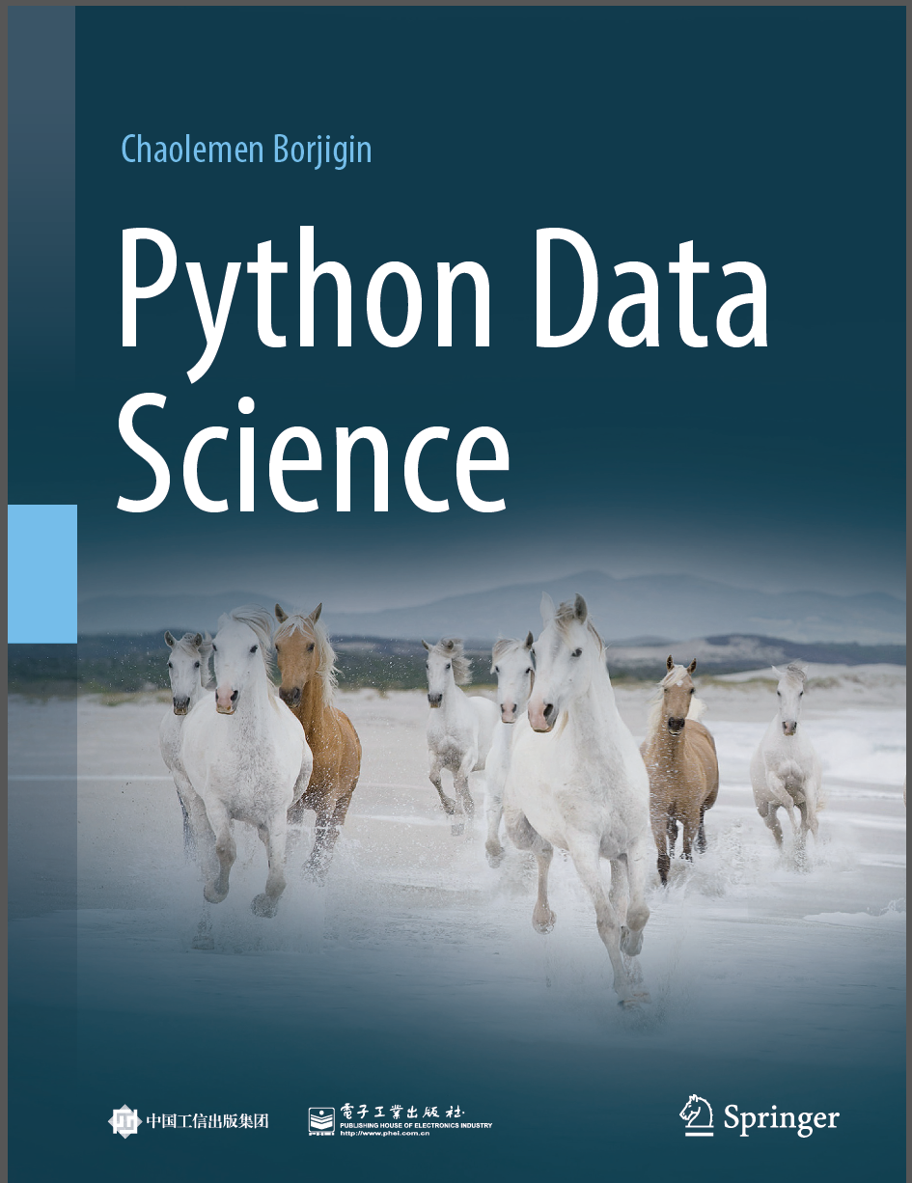
Python Data Science
Chaolemen Borjigin
Renmin University of China
chaolemen@ruc.edu.cn

Slide 2
1.2 How to setup my Python IDE for Data Science
▼ Chapter 1 Python and Data Science
► 1.2 How to setup my Python IDE for Data Science
Chaolemen Borjigin
Renmin University of China
chaolemen@ruc.edu.cn

Slide 3
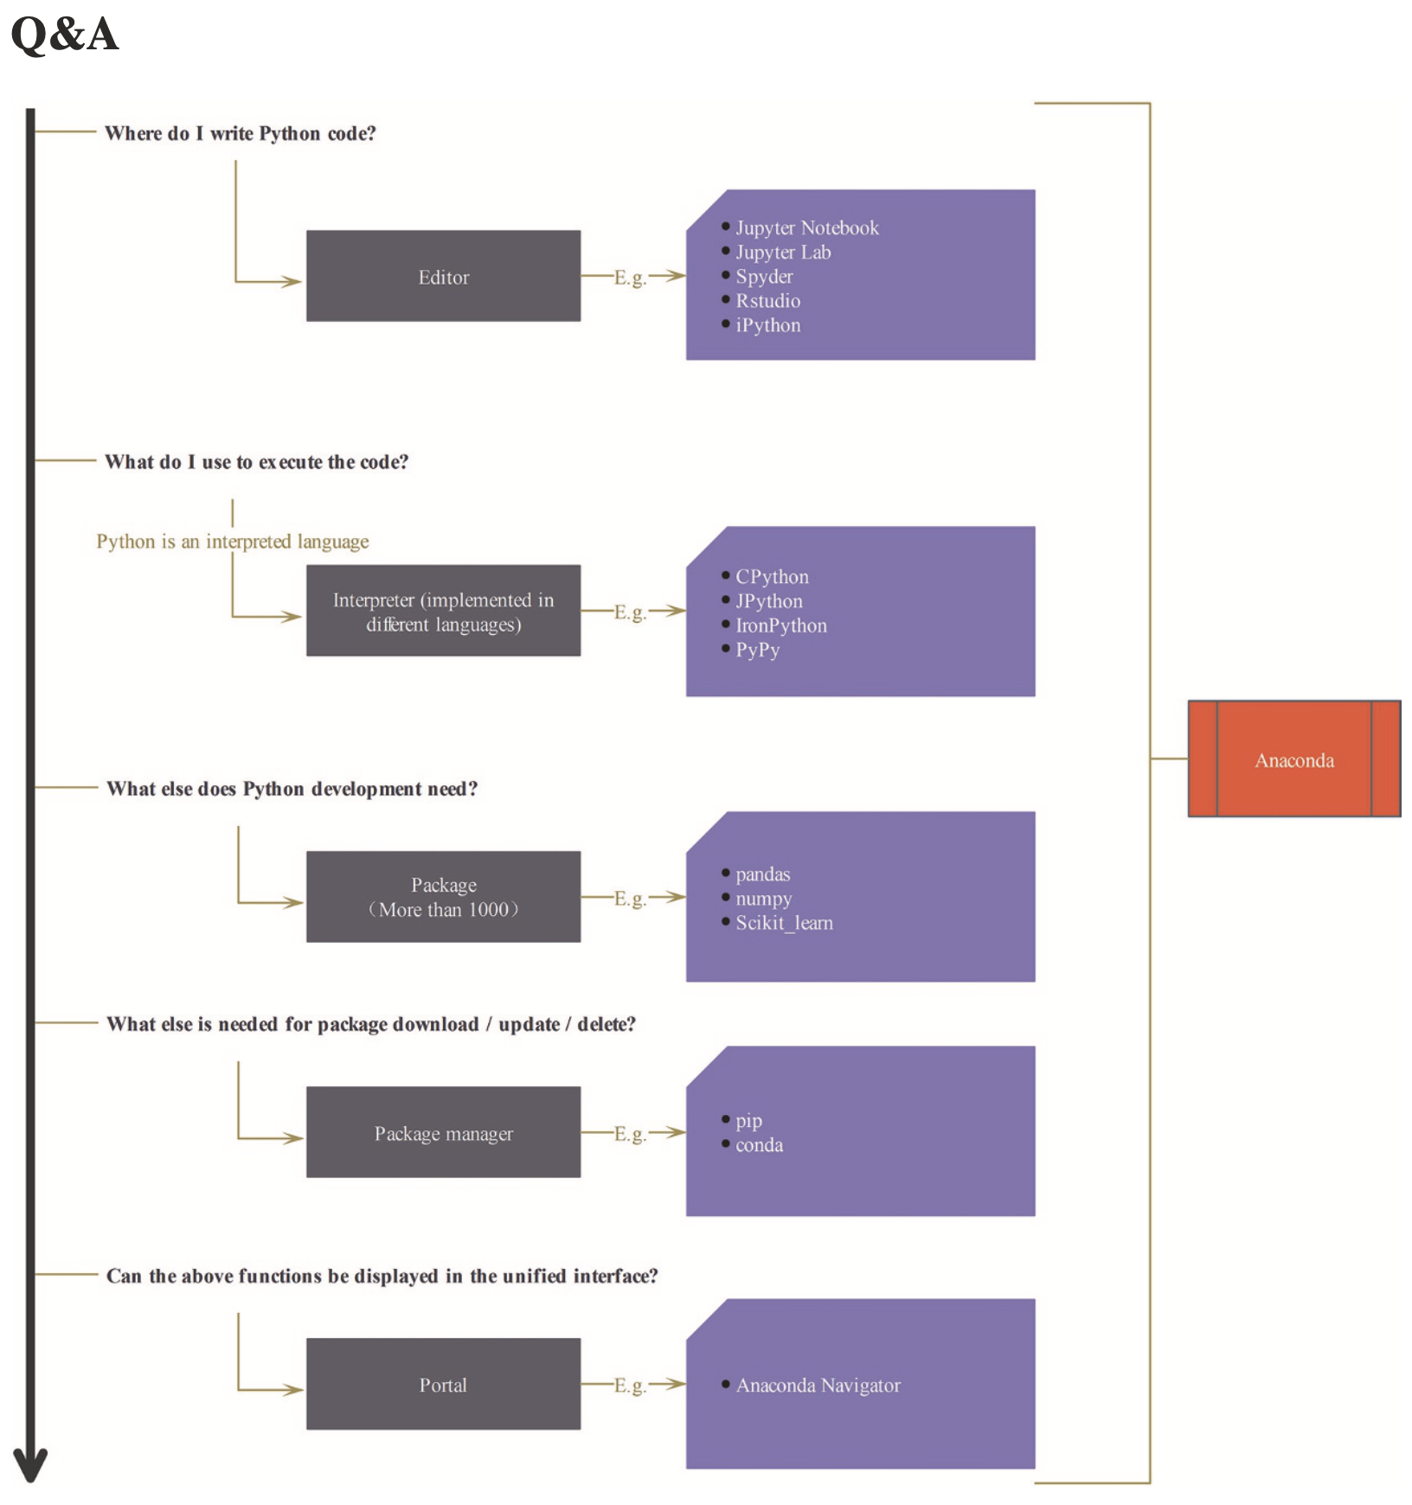
How to setup my Python IDE for Data Science
▼ Chapter 1 Python and Data Science
► 1.2 How to setup my Python IDE for Data Science

Slide 4
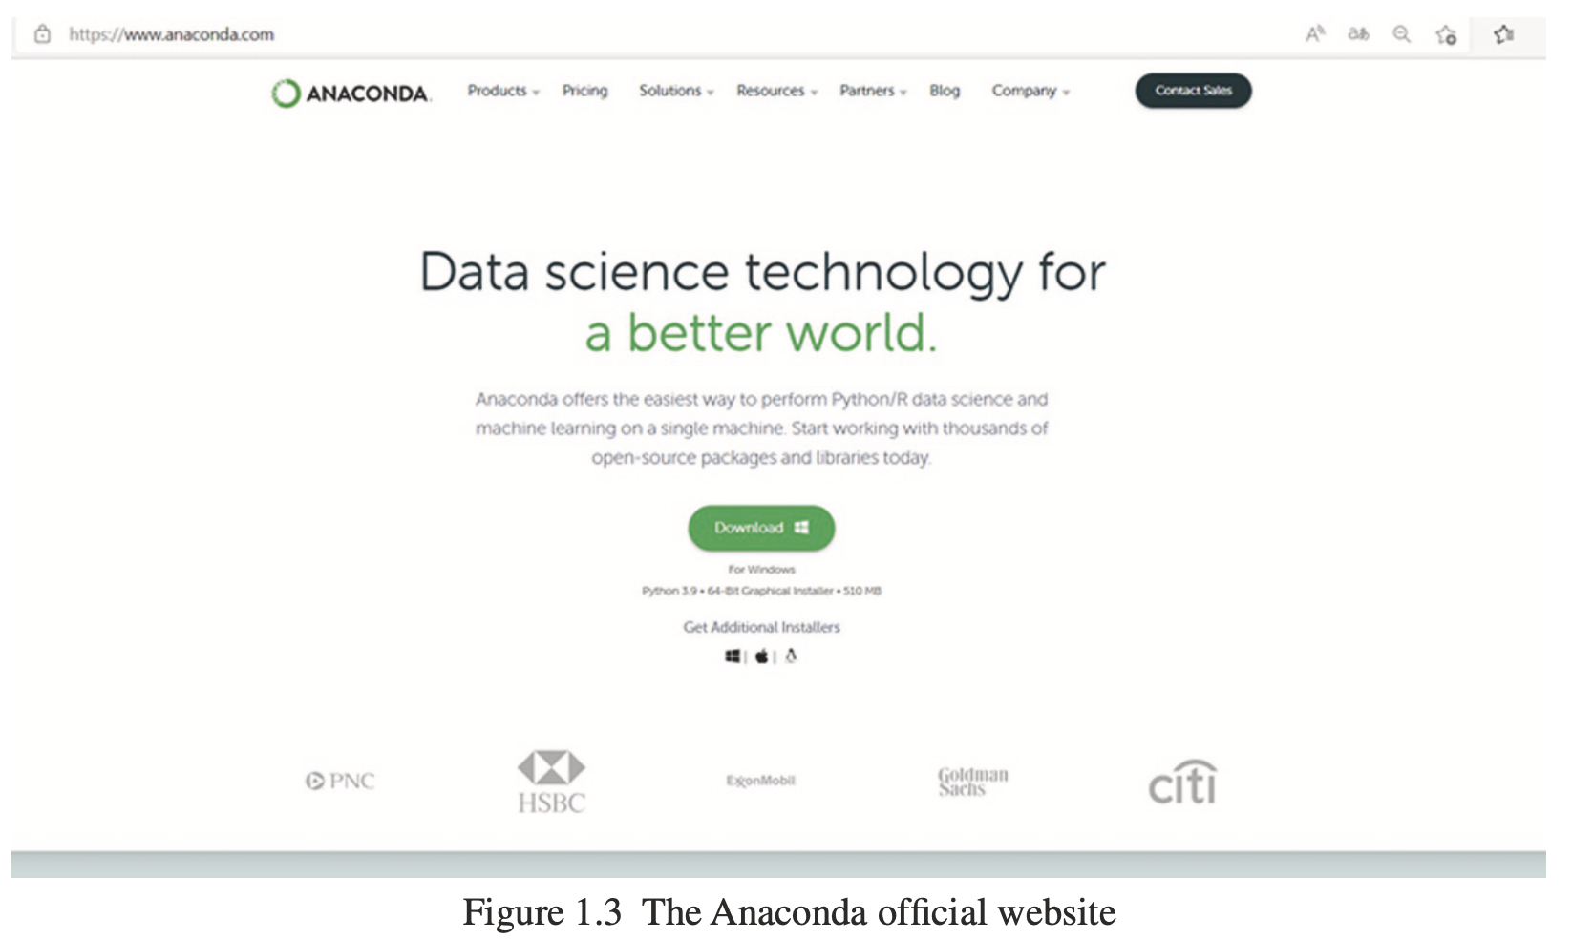
How to setup my Python IDE for Data Science
▼ Chapter 1 Python and Data Science
► 1.2 How to setup my Python IDE for Data Science
https://anaconda.com

Slide 5
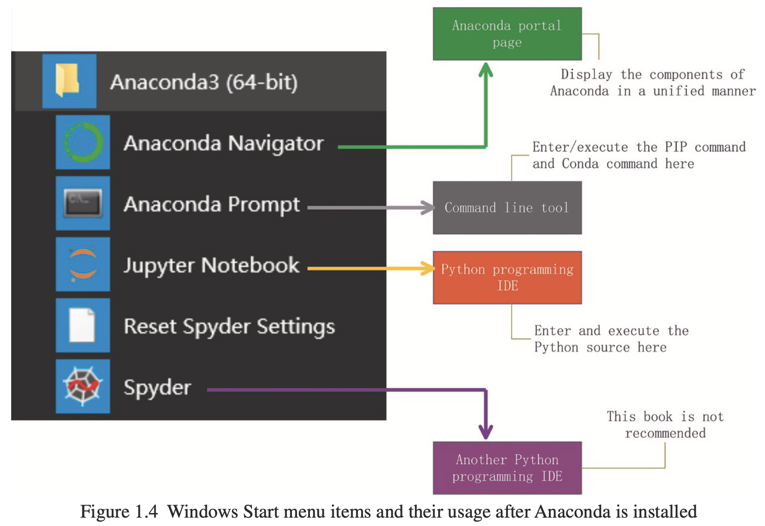
How to setup my Python IDE for Data Science
▼ Chapter 1 Python and Data Science
► 1.2 How to setup my Python IDE for Data Science

Slide 6
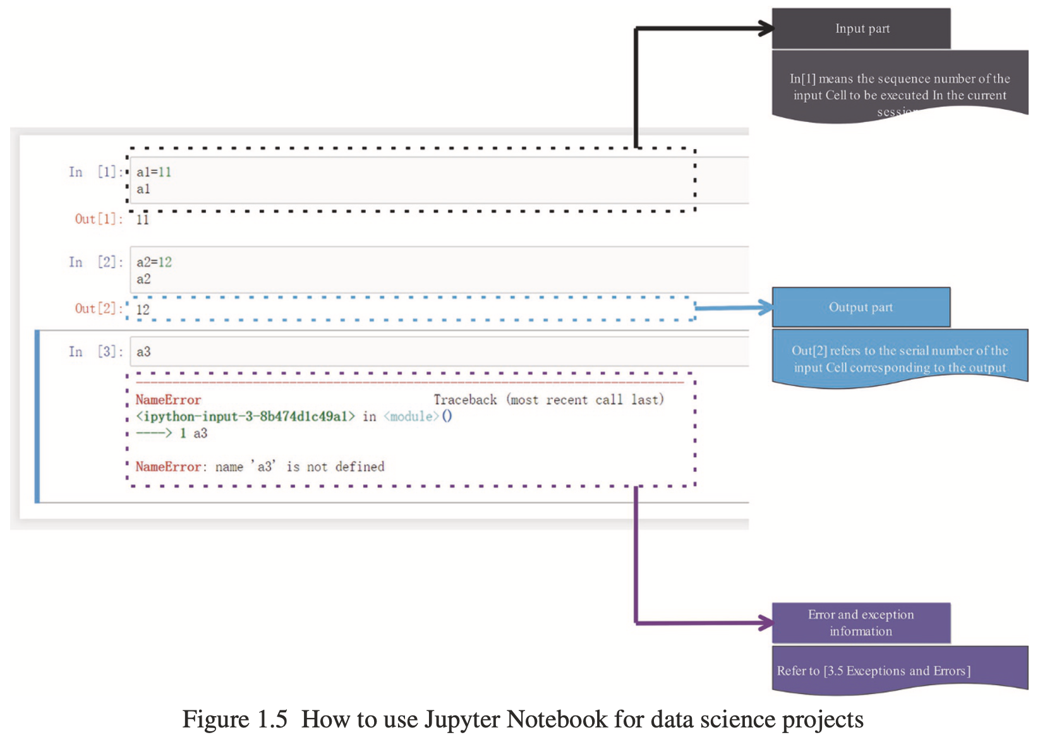
how to use the Jupter Notebook/Lab editor
▼ Chapter 1 Python and Data Science
► 1.2 How to setup my Python IDE for Data Science

Slide 7


